Slide 1
Topic 1 - Introduction
VIT 1102 - Introduction to Object Oriented Programming
By Oshadi Alahakoon

Slide 2
VIT1102 - Introduction to Object Oriented Programming
Unit Introduction
What is expected from the unit.
Workload
Assessments
Know where to find learning resources
Know contact details of your teacher

Slide 3
VIT1102 - Introduction to Object Oriented Programming
What is expected from the unit
This unit teaches you introductory object oriented programming skills using Python programming language.
Learning outcomes briefly described…
Demonstrate skills in using Python
Use of basic Python commands using an IDE
Understand and use basic programming principles
Apply suitable design strategies to develop a programming solution using python
Creating Python applications according a application specification
Exposed to top-down design
Develop algorithms using basic programming language and problem solving
Apply basic object-oriented software principles in problem solving
Creating Python applications which involves classes and objects instantiation

Slide 4
VIT1102 - Introduction to Object Oriented Programming
Workload
Course duration 15 weeks
4 hours of learning and 2 hours of tutorials per week
Tutorials to be completed before start of the next lesson.
Ongoing assessment
It is important to keep copies of the work you do in class. Every student MUST have a Flash drive/USB to store their work and bring it to class.

Slide 5
VIT1102 - Introduction to Object Oriented Programming
Assessments
4 Assessments
Laboratory Work – Parts 1 - 4
These are challenge exercises to be submitted in Weeks 3, 8, 10 and 13 (30%)
Open book
7.5% each contributes 30% in total to your final mark.
These exercises must be submitted on time for marking.
Late submissions require valid reasons( eg. medical certificate or apply special consideration).
Practical Task 1 – in class practical Test (20%)
Open book
Assess your knowledge and skills on selection structures and repetition structures
Practical Task 2 – in class practical Test (20%)
Open book
Assess your knowledge and skills on object oriented programming
Written Text – Theory test (30%)
Closed book

Slide 6
VIT1102 - Introduction to Object Oriented Programming
Learning Resources
All learning material uploaded in VU collaborate :
You are expected to check this space at least once a week.
VU Collaborate Contains
Announcements, e.g. content updates, changed requirements, etc.
PDF version of the required text
Sweigart, A. (2015). Invent Your Own Computer Games with Python 3rd Edition
Lecture notes
Tutorials + Weekly Tutorial Challenge
Revision for assessment tasks
https://vucollaborate.vu.edu.au/

Slide 7
VIT1102 - Introduction to Object Oriented Programming
Learning Resources contd..
How to use them
4 hour classes cover theory and practice.
Labs 2 hour class more practical and completing weekly challenge exercises.
During classes you will be referring to text books for further written explanations.

Slide 8
VIT1102 - Introduction to Object Oriented Programming
Introduction to Programming using Python
Todays Lecture
What is programming?
Difference between a computer language and an application
Brief overview of the structure of a computer
Writing basic Python programs
Using built-in functions

Slide 9
VIT1102 - Introduction to Object Oriented Programming
What is programming?
A computer is a machine. In order to perform a certain task, humans need to provide precise instructions to a computer. Developing and implementing such instructions is called “Programming”.

Slide 10
VIT1102 - Introduction to Object Oriented Programming
What is programming contd..
Let’s look at an example.
Say you purchased a text book for $44.70. And paid the sales person with a $50 note. What should you get as the balance? $5.30
In memory we did the calculation following a couple of steps:
Take the large number
Take the small number
Deduct the small number from the large number
Produce the output

Slide 11
VIT1102 - Introduction to Object Oriented Programming
What is programming contd..
Same precise steps can be implemented to find the balance for any transaction ( eg if the book cost 75.85 and the note was $100 still the steps to follow are the same for obtaining the balance) .
A finite series of instructions to compute a result is called an Algorithm.
Once an algorithm is implemented using a programming language, it becomes a program.

Slide 12
VIT1102 - Introduction to Object Oriented Programming
What is programming contd..
A program can accept inputs, then process them and produce an output.
In our example:
Take the large number
Take the small number
Deduct the small number from the large number - Processing
Produce the balance - Output
Input

Slide 13
VIT1102 - Introduction to Object Oriented Programming
Introduction to Programming using Python
Todays Lecture
What is programming?
Difference between a computer language and an application
Brief overview of the structure of a computer
Writing basic Python programs
Using built-in functions

Slide 14
VIT1102 - Introduction to Object Oriented Programming
Difference between a computer language and an application
A programming language is an artificial language designed to communicate instructions to a machine, particularly a computer.
Examples of computer languages are:
Python, Java, Visual Basic, C, C++, C# and so on.
For a comprehensive list of programming languages visit:
https://en.wikipedia.org/wiki/List_of_programming_languages
An application is a collection of programs written using one or more programming languages. A computer application allows you to perform a specific task such as word-processing or maintaining a spreadsheet. For example you can use the popular Microsoft Word application for word-processing and Microsoft Excel to manage a spreadsheet.

Slide 15
VIT1102 - Introduction to Object Oriented Programming
Introduction to Programming using Python
Todays Lecture
What is programming?
Difference between a computer language and an application
Brief overview of the structure of a computer
Writing basic Python programs
Using built-in functions

Slide 16
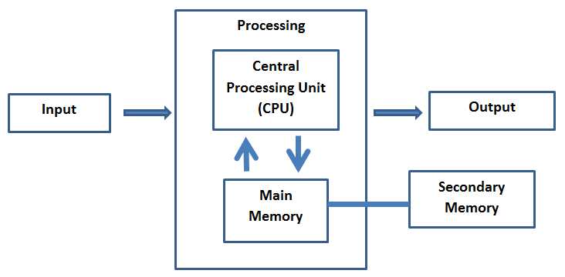
VIT1102 - Introduction to Object Oriented Programming
Brief overview of the structure of a computer

Slide 17
VIT1102 - Introduction to Object Oriented Programming
Brief overview of the structure of a computer contd..
The Central Processing Unit (or CPU) is the part of the computer that is process every instruction that runs on the computer. CPU is a highly complex, extensive set of electronic circuitry.
It is extremely fast, if your computer is rated at 3.0 Gigahertz, it means that the CPU will process three billion instructions per second.
The main memory store information required by the CPU and is nearly as fast as the CPU. But the main memory is volatile and will get erased off when the computer is turned off.
The Secondary Memory is also used to store information, but it is much slower than the main memory. The advantage of the secondary memory is that it can store information even when there is no power to the computer.
Examples of secondary memory are disk drives or flash memory (typically found in USB sticks and portable music players).
The Input and Output Devices are simply our screen, keyboard, mouse, microphone, speaker, touchpad, etc. They are all of the ways we interact with the computer.

Slide 18
VIT1102 - Introduction to Object Oriented Programming
Introduction to Programming using Python
Todays Lecture
What is programming?
Difference between a computer language and an application
Brief overview of the structure of a computer
Writing basic Python programs
Using built-in functions

Slide 19
VIT1102 - Introduction to Object Oriented Programming
Writing basic Python programs
What software do we need for this unit?
In this unit we use Python programming language to understand basics of programming.
We use Pycharm Edu which is an Integrated Development Environment (IDE) which installs Python programming language as well.
PyCharm is free software to install on your home computer.
Please find a document with PyCharm installation instructions in VU Collaborate.

Slide 20
VIT1102 - Introduction to Object Oriented Programming
Why learn Programming?
https://www.youtube.com/watch?v=IAtAilkGsRE
This is just an ice breaking session for the first lesson

Slide 21
VIT1102 - Introduction to Object Oriented Programming
Writing basic Python programs
What is an IDE?
Definition given in Wikipedia is as follows:
“An integrated development environment (IDE) is a software application that provides comprehensive facilities to computer programmers for software development. An IDE normally consists of a source code editor, build automation tools and a debugger. Most modern IDEs have an intelligent code completion”

Slide 22
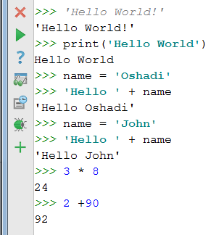
VIT1102 - Introduction to Object Oriented Programming
Writing basic Python programs
In PyCharm we can either use:
Python console to run commands.
OR
can create projects to save our code as programs.
Tute 1 Excercises

Slide 23
VIT1102 - Introduction to Object Oriented Programming
Writing basic Python programs
As described before, a program is a set of instructions to the computer.
The computer will accept inputs and process them according to a “program” ( a set of instructions) and produce an output.
Python programs can read inputs from the output area using input() built-in function
Next step is processing: changing the inputs to produce the expected output
Python programs can display outputs in the output area using print() built-in function

Slide 24
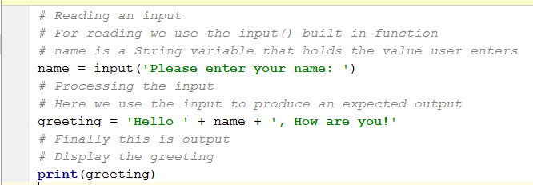
VIT1102 - Introduction to Object Oriented Programming
Writing basic Python programs
Example 1
Tute 1 exercises use built-in functions for input output
INPUT
PROCESSING
OUTPUT

Slide 25
VIT1102 - Introduction to Object Oriented Programming
Introduction to Programming using Python
Todays Lecture
What is programming?
Difference between a computer language and an application
Brief overview of the structure of a computer
Writing basic Python programs
Using built-in functions

Slide 26
Using built-in functions
print() function
print() function use one parameter. You can use this function by first assigning a value to the parameter.
You can also use print() function with an argument in it to print in the output window.
OR
greeting = “Hello, World!”
print(greeting)
print(‘Hello, World!’)
Note: Use either single quotation or double quotation
print("Hello, World!")

Slide 27
Using built-in functions contd..
input() function
input() function also use one parameter.
input() function returns the value user input. Therefore, you need a variable to hold the returned value.
Explanation:
input (“What is your name?”) will print the question on the output area. User can type the answer to the question. Then the answer get assigned to myName variable.
print(myName) will print the contents of the variable to the output area.
myName = input (“What is your name?”)
print(myName)

Slide 28


VIT1102 - Introduction to Object Oriented Programming
Class Exercise 1
Add a new python file to your existing package. Type the following code.
Run this program. You will NOT see any OUTPUTS as there is no print() commands in your code.
Alter your code to get the following output. (What you need to input during the interaction is in green letters).
Note: there are spaces next to the word “Hello”and between the two names. Make sure your outcome has these spaces.
Alter your code to add an exclamation mark to the end of the greeting. Output should change as follows:
Hello Oshadi Alahakoon!

